Slide 1
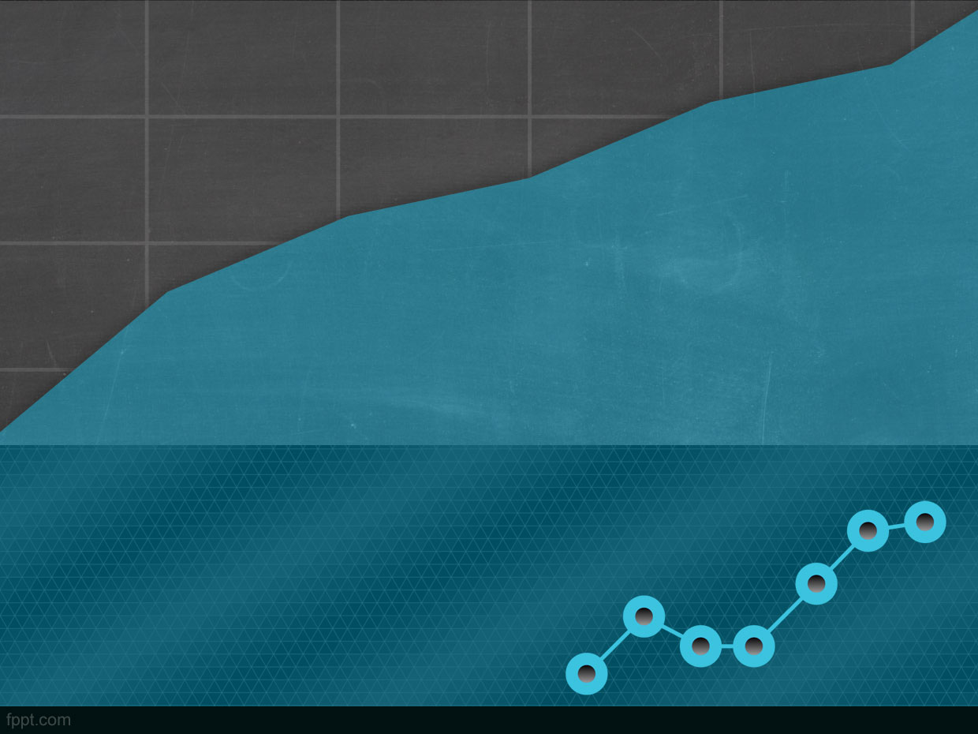
Netflix Stock Profile
Ravindraraju Penmetsa
Data Visualization Developer
Yahoo Finance!

Slide 2
Agenda-
Analyze Netflix stock performance using different visualizations
  Distribution of 2017 Netflix Stock Prices by Quarter
  Earnings Per Share in Cents
  Quarterly earnings and revenue
  Revenue percentage that constitutes earnings
  Netflix vs Dow jones

Slide 3
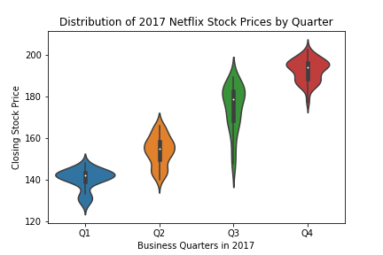
Distribution of 2017 Netflix Stock Prices by Quarter
Prices fluctuated the most in the 3rd Qtr.
The lowest price is around $120 and highest price is $210

Slide 4
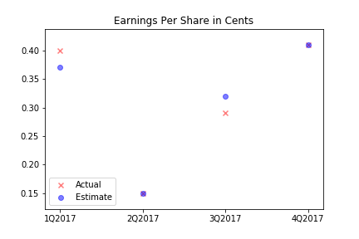
Earnings Per Share in Cents
Actual and estimate per share is same or almost same in all four Qtrs.

Slide 5
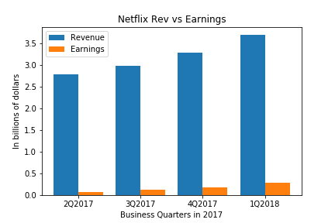
Quarterly earnings and revenue
Revenue and earning followed the same upward trend

Slide 6
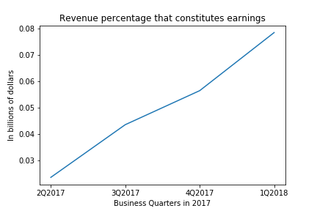
Revenue percentage that constitutes earnings
Earning percentage of revenue has increased from 2% in first qtr. to 7% in fourth qtr.

Slide 7
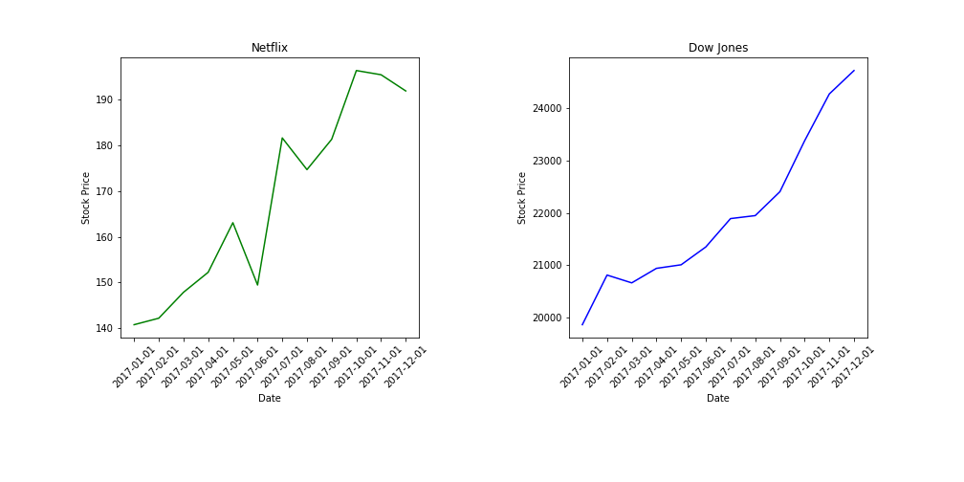
Netflix vs Dow jones
Netflix stock has followed the Dow jones index to most extend except for 2 instances in 3rd Qtr. and 4th Qtr., where the stock performance has been bumpy.

